Slide 1


Azure Load Balancer
Azure load balancer allows you to distribute traffic to your backend pool which can contain virtual machines or virtual machine scale set or containers. An Azure load balancer provides high availability for your application. The Azure load balancer is a fully managed service itself.
Load Balancer
Backend-Pool

Slide 2
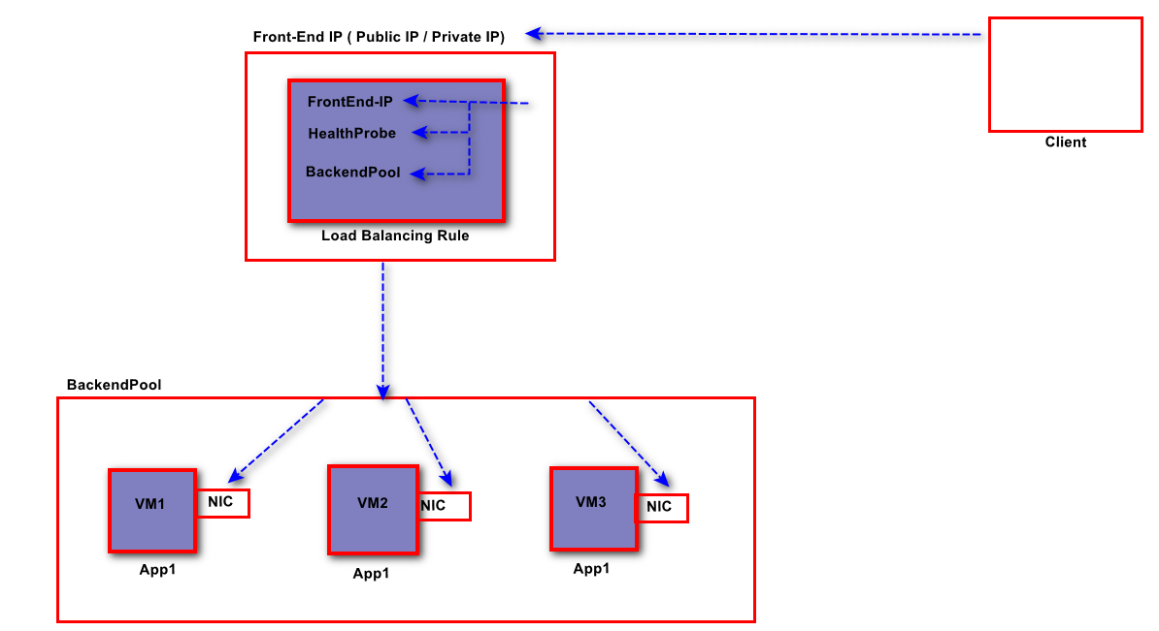
Azure Load Balancer- Functions

Slide 3
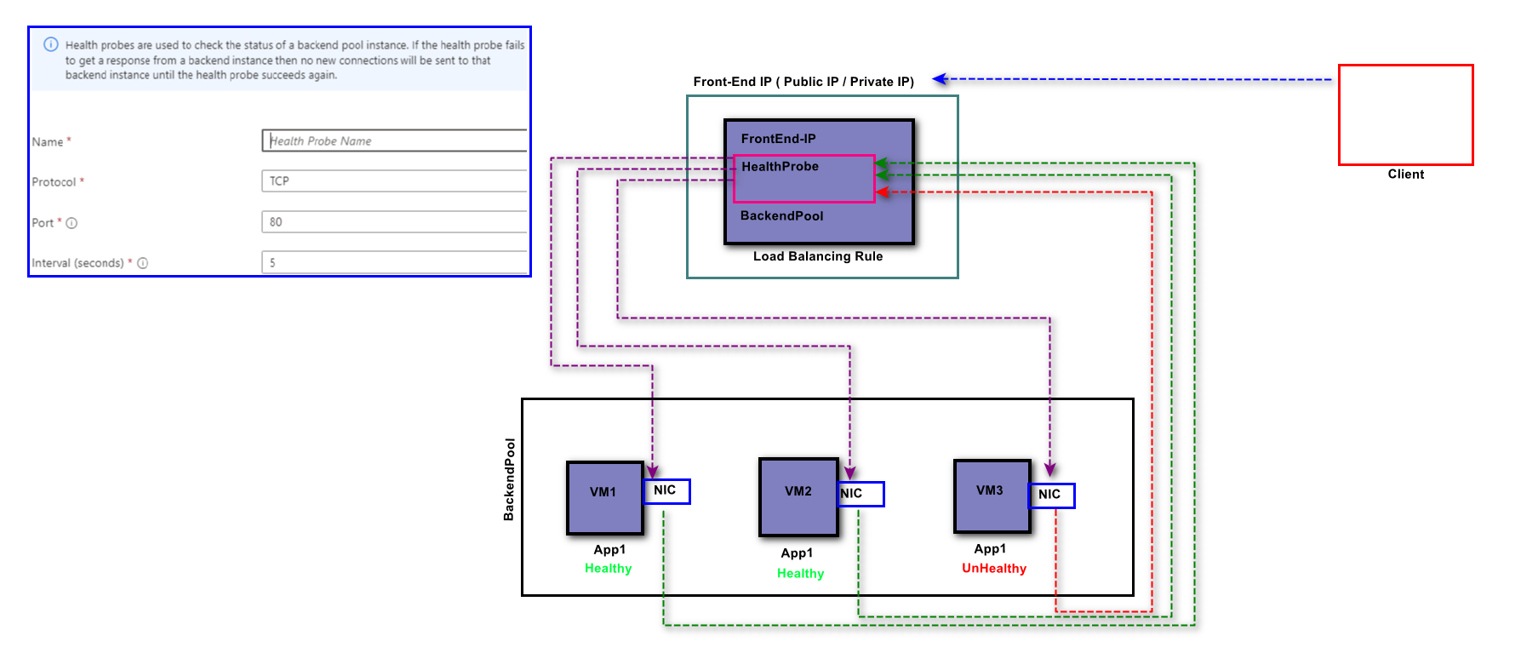
Azure Load Balancer- Health Probe
An Azure Load Balancer health probe is a feature that detects the health status of your application instances. It sends a request to the instances to check if they are available and responding to requests. Azure Load Balancer rules require a health probe to detect the endpoint status.

Slide 4
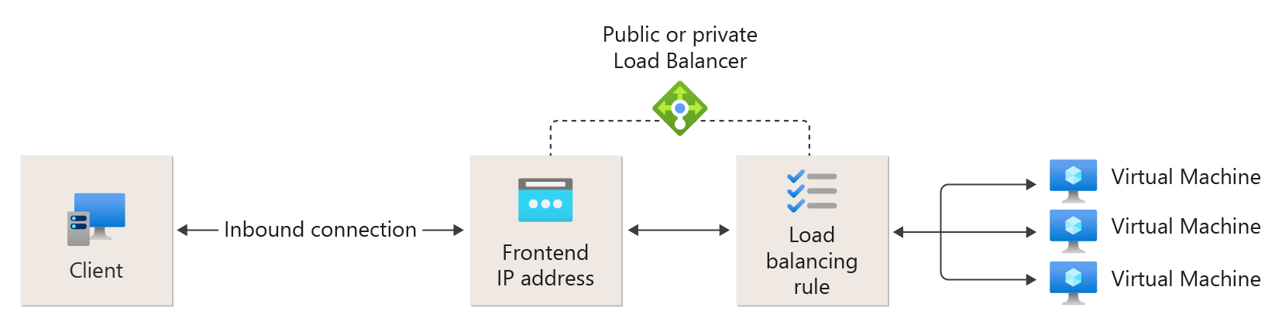
Azure Load Balancer- Load Balancing Rule
Azure Load Balancer rules define how incoming traffic is distributed to the backend pool of virtual machines. These rules map a frontend IP configuration and port to multiple backend IP addresses and ports.

Slide 5
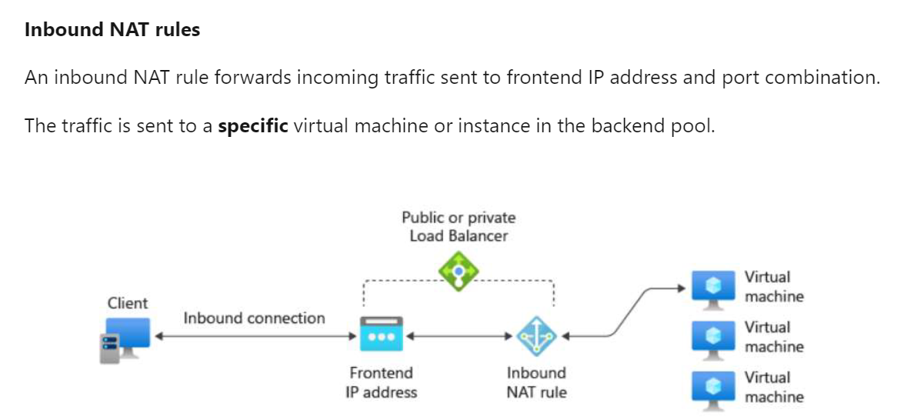
Azure Load Balancer- Inbound NAT Rules

